Slide 1
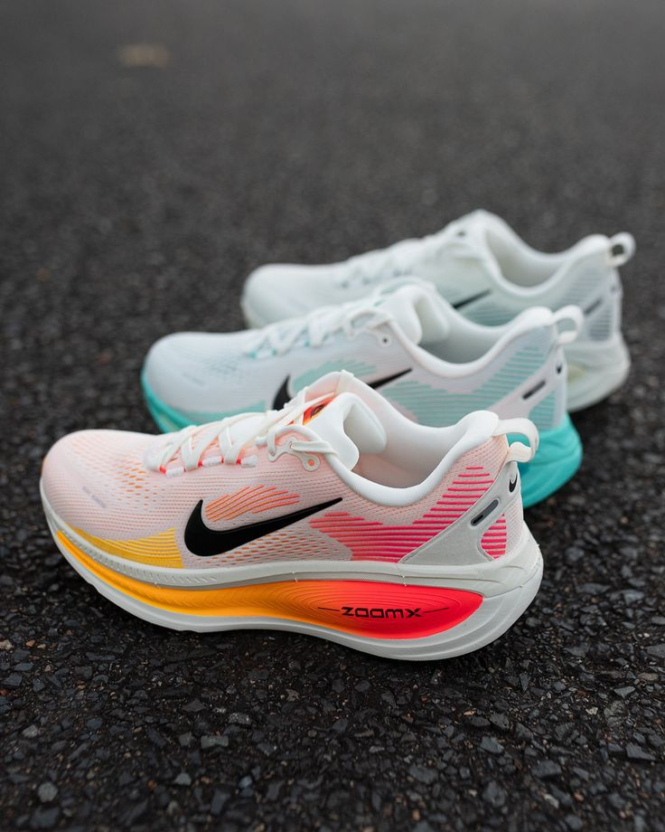
Running Shoes Campaign – Digital Marketing Performance
This dashboard is designed exclusively for CMOs and senior executives to support strategic decision-making. It provides a one-page overview of:
• Simulated market demand for running shoes
• Competitive performance benchmarks
• Digital channel investment and efficiency metrics

Slide 2
Industry Assumptions:
• Sector: Athletic footwear (running shoes)
• Market: Mexico, with simulated demand data from Google Trends
• Timeframe: January 2023 to December 2024
• Competitors: Nike, Adidas, Puma, Reebok
• Channels: Paid Search, Display, Social, Referral, Organic Search
Data Assumptions:
• CTR, CPC, and Engagement Rate are simulated based on industry benchmarks
• Estimated Spend calculated using CPC × Estimated Clicks (10,000 per brand)
• Demand modeled from Google Trends and scaled to represent monthly sales
**CTR (Click-Through Rate)** | **CPC (Cost Per Click)**

Slide 3
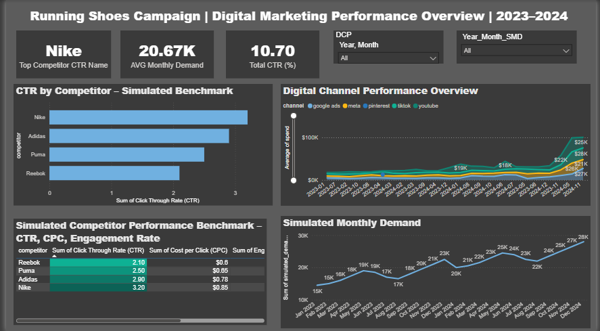

Slide 4
Wireframe Overview
Dashboard Layout Highlights:
Top Section:
• Brand spotlight (Top CTR)
• KPI cards: Average Monthly Demand, Total CTR y Highlighted KPI
Middle Section:
• Bar chart: CTR by Competitor
• Line chart: Digital Channel Spend Over Time
Bottom Section:
• Table: CTR, CPC, Engagement Rate, Estimated Spend
• Line chart: Simulated Monthly Demand

Slide 5
Build Plan
Technologies Used:
• Data Preparation: Excel, Power BI Data Model
• Visualization: Power BI Desktop
Key Tasks:
• Data cleaning and transformation
• KPI calculation and formatting
• Visual alignment and storytelling
• Documentation of assumptions
Potential Risks:
• Limited access to real campaign data
• Misinterpretation of simulated metrics
• Visual overload if not properly scaled

